Slide 1
EPOD SCREENS

Slide 2
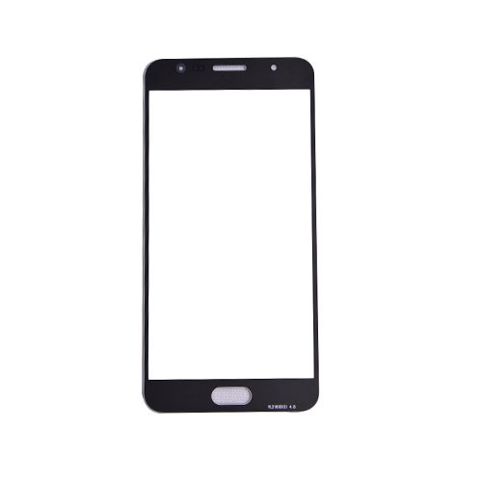

LAUNCH SCREEN

Slide 3


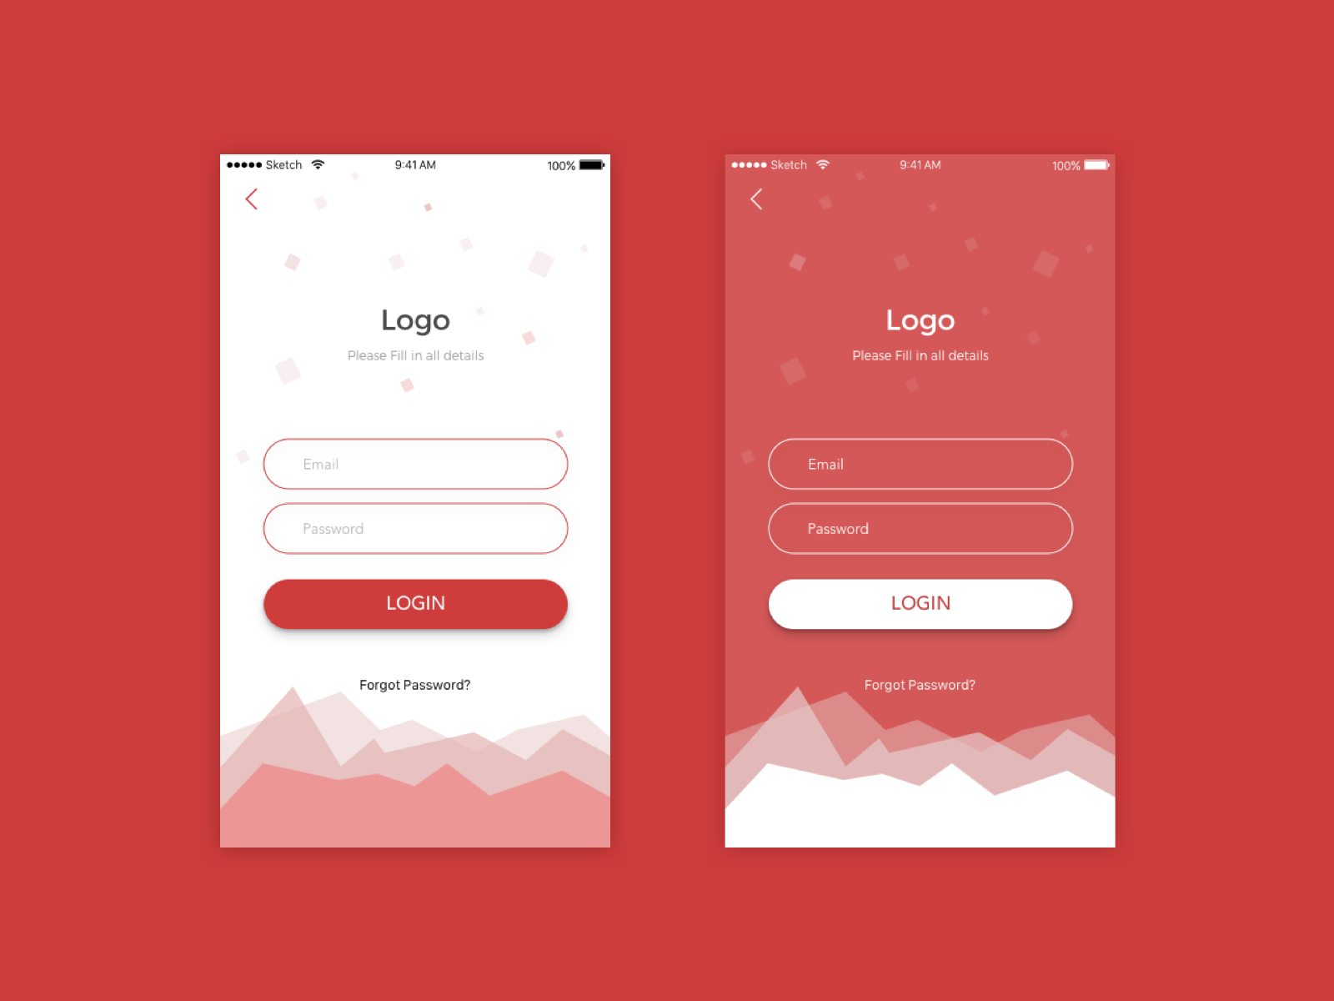



LOGIN SCREEN
EPOD
Forgot Password

Slide 4
LOGIN SCREEN-2
EPOD
Transporter code
Truck No
Forgot Password

Slide 5







DASHBOARD
SCREEN 3
MY LIFTING
2000 MT
TRACKING COVERAGE
(500 MT
LR MISSING
NO TRACKING
LOCATION MISSING
CUSTOMER ACK.
INVOICE READY

Slide 6

MY LIFTING
2000 MT
TRACKING COVERAGE
(500 MT
SCREEN 3
LR MISSING
NO TRACKING
LOCATION MISSING
CUSTOMER ACK.
INVOICE READY
PROFILE
NOTIFICATION
HISTORY

Slide 7





DASHBOARD
Ruby Logistics
SCREEN 3
MY LIFTING
2000 MT
TRACKING COVERAGE
(500 MT
LR MISSING
NO
TRACKING
LOCATION MISSIG
CUSTOMER ACK.
INVOICE READY

